Slide 1
Candy Bar Problem

Slide 2
The Problem...
65 candy bars were to be shared by a group of children. Each Pascal bar was cut in half, and one piece was given to each child. Every Fermat bar was cut in thirds, and each Mandelbrot bar was cut in quarters, and these pieces were equally distributed to the children. How many children were in the group if all 65 candy bars were shared?

Slide 3
Hint #1
We know that we need to have a number of children that can be split into halves, thirds, and fourths since nothing was left over.
Consider looking at the denominators. Can those be used to determine the divisibility?

Slide 4
2 | 3 | 4
2 | 3 | 4
4 | 6 | 8
6 | 9 | 12
8 | 12 | 16
10 | 15 | 20
12 | 18 | 24
12/2 = 6 12/3 = 4 12/4 = 3
6 + 4 + 3 = 13 bars

Slide 5
Hint #2
Since the least common multiple, 12, only gave us 13 candy bars, we need to figure out which common multiples will give us 65 candy bars.
Try it out! Continue with the table to discover the different possibilities.

Slide 6
2 | 3 | 4
2 | 3 | 4
4 | 6 | 8
6 | 9 | 12
8 | 12 | 16
10 | 15 | 20
12 | 18 | 24
24 | 24 | 36
36 | 36 | 48
48 | 48 | 60
60 | 60

Slide 7
How many bars did you get per children?
24 children → 26 bars
36 children → 39 bars
48 children → 52 bars
60 children → 65 bars

Slide 8
Hint #3
Hmmm, could we have used a proportion at anytime? How we would set that up?

Slide 9
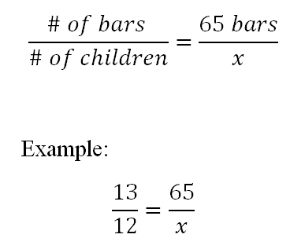
The Proportion...
Does it work with all of the multiples that were found?
What can we conclude?

Slide 10
Final Conclusion/Review...
We noticed that we had to have a number that would be divisible by the denominators.
With that, we created a table and saw that with the common multiples we can determine how many candy bars there were per amount of children.
We also noticed that you could use a proportion to see that there were 60 children in the group for all 65 candy bars shared.

